Slide 1
Gonfreville Plant: New H2 recip compressor to supply PSA unit

Slide 2
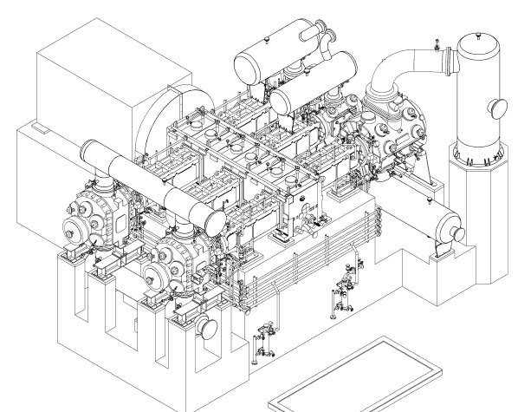
The Machine / Purpose and lay out
2
8ème Commission Machine Tournante 14/06/2011, Patrick Ferrage
-

Slide 3
Purpose / the project
Recip compressor to compress tail gas of styren monomer unit in Gonfrevile plant and send H2 to RN
Tail gas from monomer unit is with high H2 content, MW about 7.
With current lay out, tail gas is sent to fuel gas network and burnt.
Raffinery (RN) needs H2, all project is based on synergy between TPF and RM. TPF will send all H2 (purified tail gas) to RN
Scope of project for TPF:
1 recip compressor and all interstage coolers and separators
1 PSA
All connections to RN
Budget : about 60 M€ (Compressor 7,5M€ without its interstage vessels)

Slide 4
The compressor
1 compressor from Thomassen to compress gas with high H2 contents from 1,6 bara @ 35°C up to 35 bara, MW =7, capacity is 7000kg/h, which means 20 000 m3/h at suction, @ 371 RPM (4m/s linear speed, stroke 320mm)
Gas also includes CO2, water, styrene, benzene,N2 : lot of condensates, risk of corrosion because of high partial pressure of CO2 with water, risk of polymerisation with styren
Non lub Machine required because PSA down stream the compressor does not withstand oil.
4 stages of compression, with maximum discharge temperature of 135°C
2 Double Acting cylinders at first stage (990mm bore), 1 DA cylinder (940mm bore) for 2nd stage, 1 DA cylinder ( 615mm bore) for 3rd stage, 1 DA cylinder ( 450mm bore) for 4th stage. A total of 52 valves
Driven by a 4.2MW from Converteam, flanged to crankshaft, only 1 pedestal bearing

Slide 5
Two « New » Technologies used for this Compressor
Free Floating Piston :
It’s a non lub machine, to minimize rider rings wear.
To minimize « hot spots » between rings and liner and minimize polymerization risks
Developed 10 years ago, systematically fitted on large bores since 2005, good feed back
Monitoring dedicated to reciprocating machine (hardware):
Casing vibrations (accelerometers horizontal)
Cross head guide vibration (accelerometers vertical)
Rod drop, XY rod run out and position (eddy current probes)
Temperature of all bearings (con rod with wifi measurement from Kongsberg)
Temperature of all valves suction and discharge (TW fitted on valve covers)
Gas temperature of rod packing leaks
X Y vibration and position of motor shaft
Pressure measurement inside cylinders for PV diagram analysis ( performance tracking, failure of valves, piston rings, rod load, reversal)

Slide 6
Monitoring software :
Compressor completly fitted with Bently Nevada and System 1 (including rule pack), all probes according Bently Requirement, remote connection to system One (from Total Petrochemicals offices or Bently Nevada offices.
Typical parameters which are followed:

