Slide 1
Rotordynamics in ANSYS 14.5
Aline Beley
November 2012

Slide 2
Outline
Brief reminder of rotordynamics capabilities in ANSYS
Rotordynamics Documentation
Rotordynamics in WB environment
Bearing definition in WB 14.5
Geared Shaft dynamics: ROMAC report #523 “A twelve degree-of-freedom gear-mesh stiffness matrix for helical and spur gears for rotor dynamics”
Optimization of a rotor bearing system: ROMAC report #556 “Constrained design optimization of rotor-tilting pad bearing systems” – in progress

Slide 3
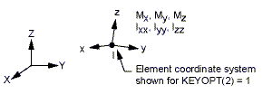
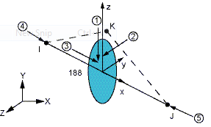
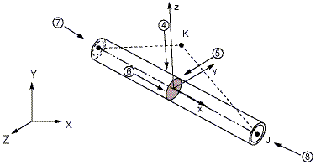
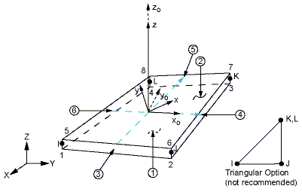
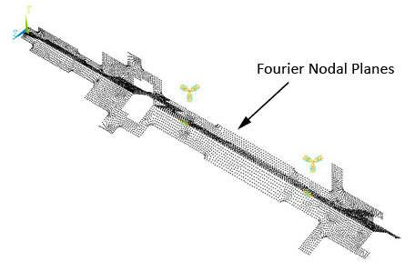
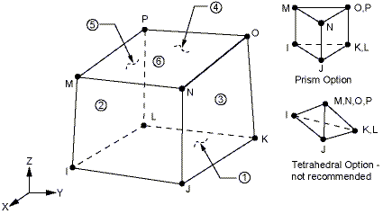
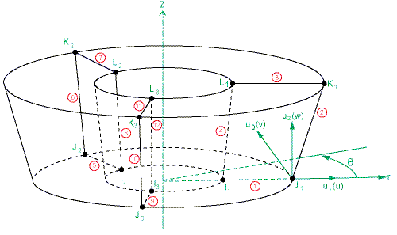
Structural Elements for Rotating Parts
Element Type | Detail
Structural Mass | MASS21
3D Beam | BEAM188 BEAM189
3D Pipe | PIPE288 PIPE289
Structural Shell | SHELL181 SHELL281
3D Structural Solid | SOLID185 SOLID186 SOLID187
General Axisymmetric Solid | SOLID272 SOLID273

Slide 4
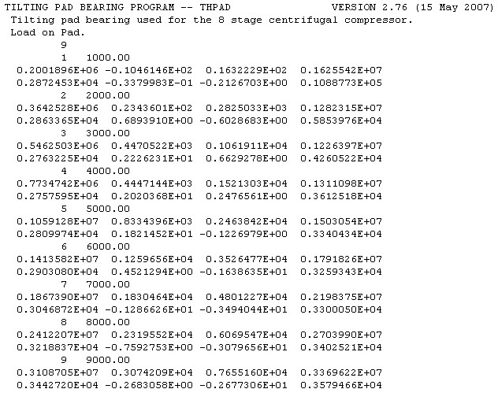
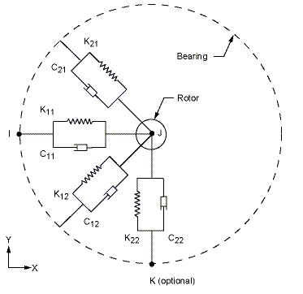
Bearing Modeling
Bearing element choice depends on:
Shape (1D, 2D, 3D)
Cross terms
Nonlinearities
Specific Bearing Element
THPAD import
Notes:
Inserted timings for sequential appearance of objects [Brad].

Slide 5
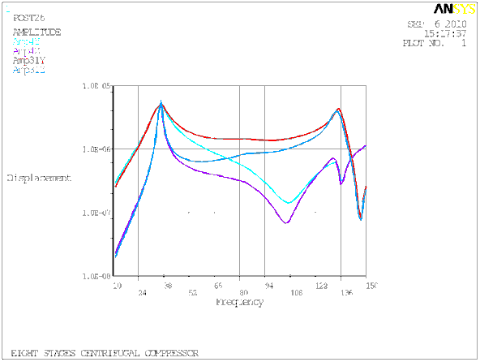
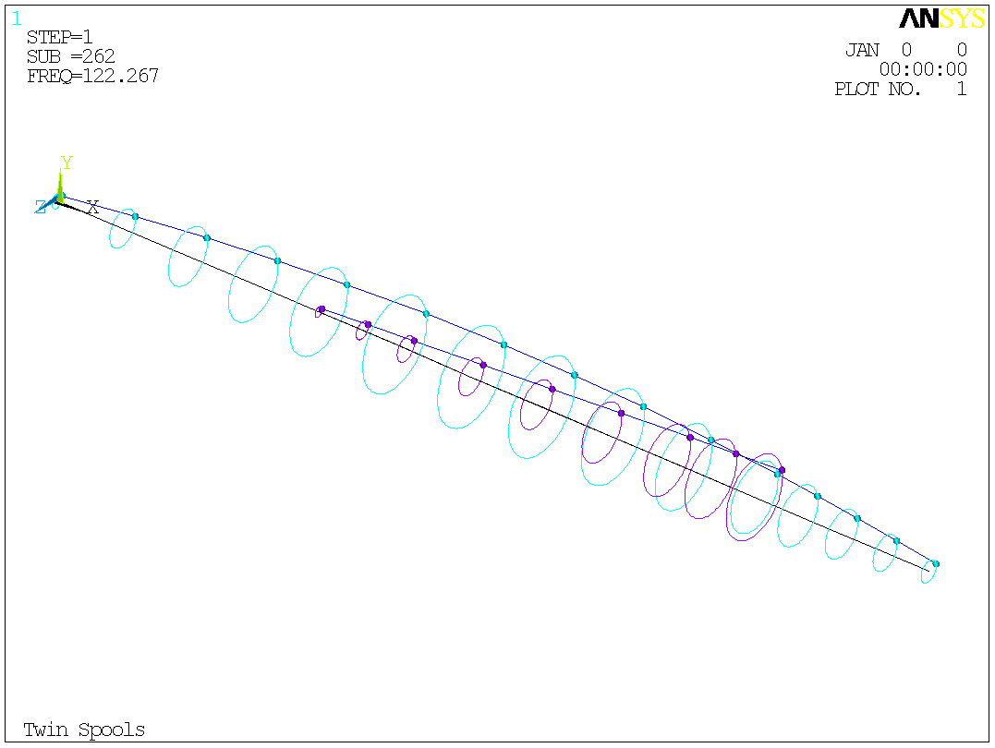
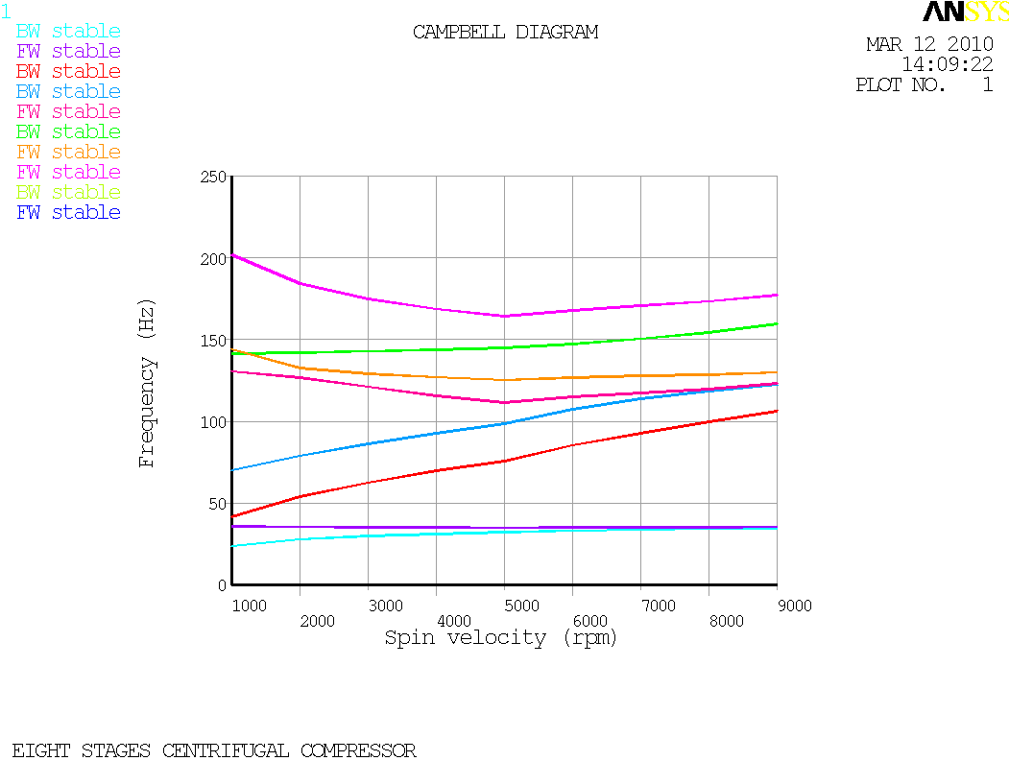
Main Features
Multi-spools simulation (component based rotational velocity)
Linear and non-linear static analysis (thermal effect, centrifugal effect,…) for linear perturbation analysis (prestress modal or harmonic analysis)
Modal analysis (DAMP and QRDAMP eigensolvers)
Harmonic analysis for synchronous (unbalance) or asynchronous response
Orbit plots
Campbell diagram – stability maps
Whirl animation
Critical Speed Map

Slide 6
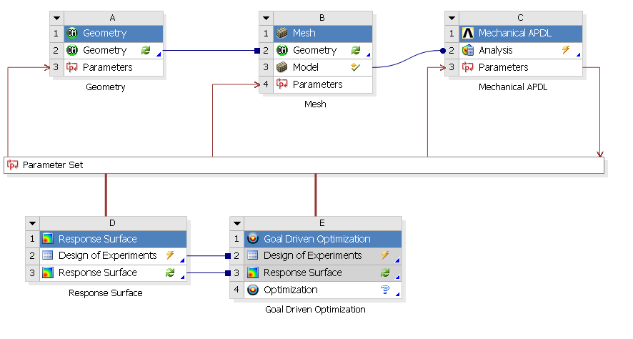
Global Procedures and WB Environment
No specific license is required (Structural)
CAD import and automatic meshing
Flexibility of the supporting structure and/or disks
Direct connection to other ANSYS tools
ANSYS APDL Solver
Geometry
Mesh Simulation
Parameters: geometry, bearing stiffness, loading, …
Design Exploration Tools

Slide 7
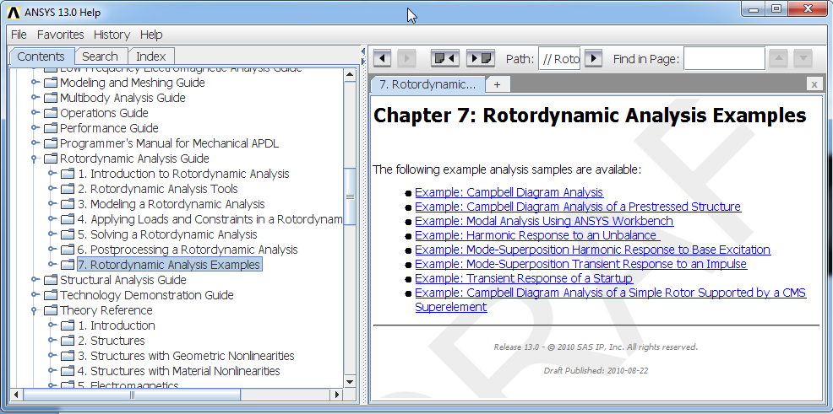
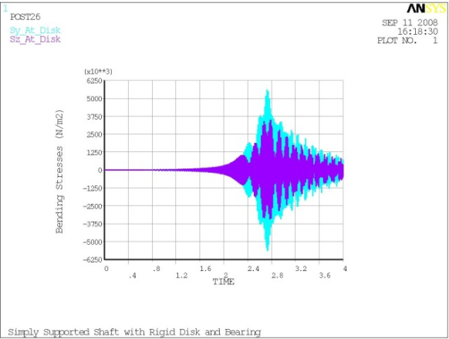
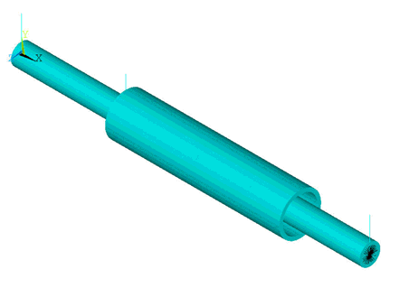
Rotordynamics Analysis Guide
Analysis Guide specific to Rotordynamics

Slide 8
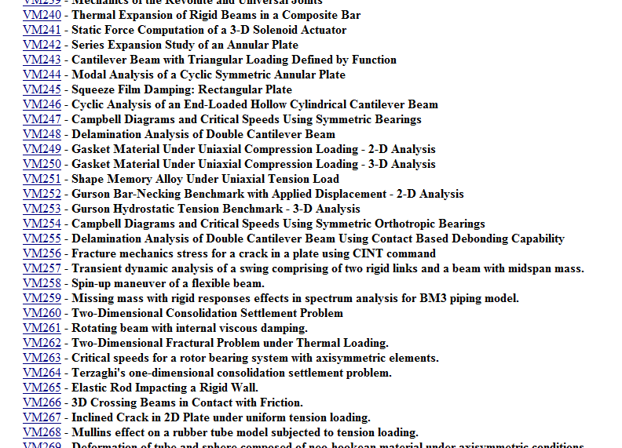
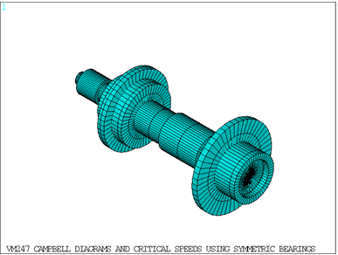
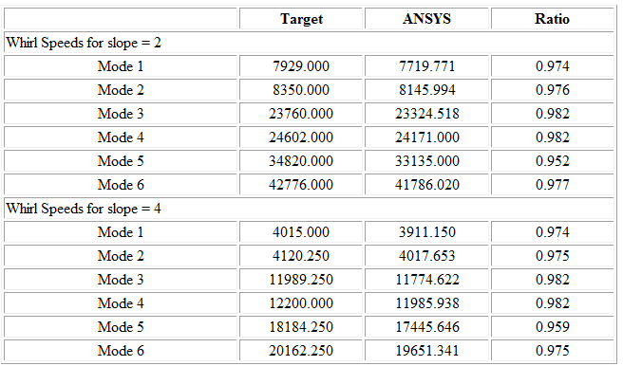
Verification Manual
VM247
Verification Tests

Slide 9
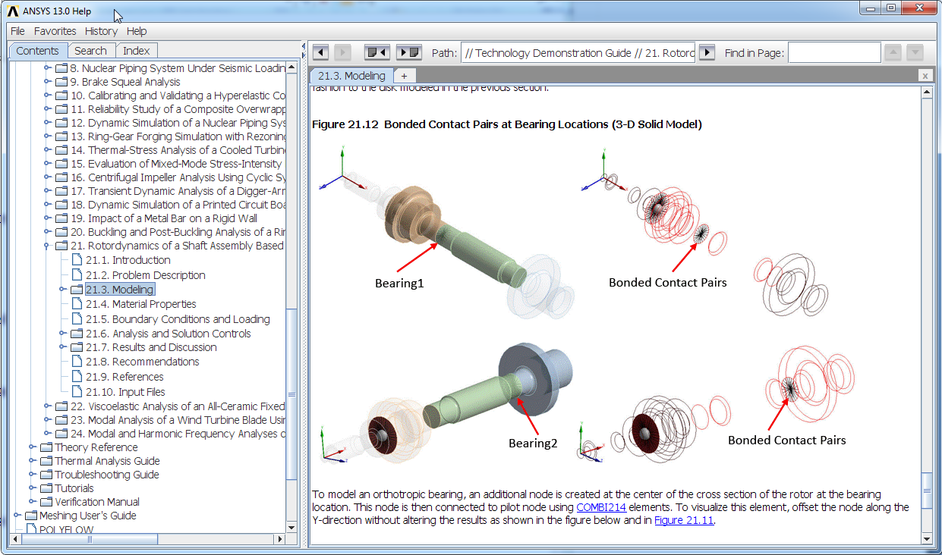
Technology Demonstration Guide

Slide 10
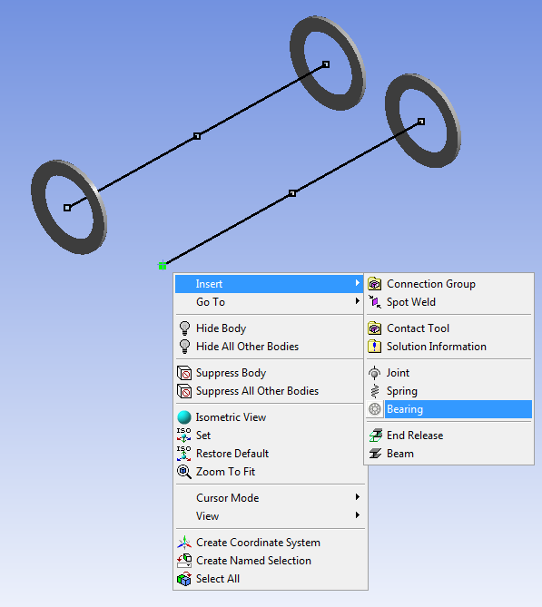
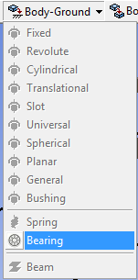
Bearings Definition in WB 14.5
Bearing based on COMBI214 elements can now be defined directly in WB as Body-Ground support
Right click on the targeted vertex

Slide 11
Bearings Definition in WB 14.5

Slide 12
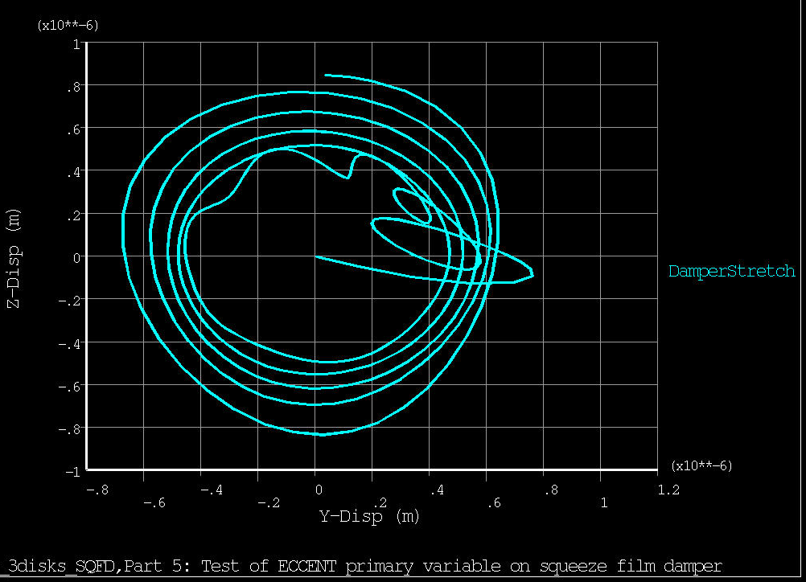
Bearings Parameters In 14.5
Stiffness and damping coefficients can vary with the eccentricity of the shaft centerline
…
Displacement of the center node of a squeeze film damper with both eccentricity and velocity dependent characteristics

Slide 13
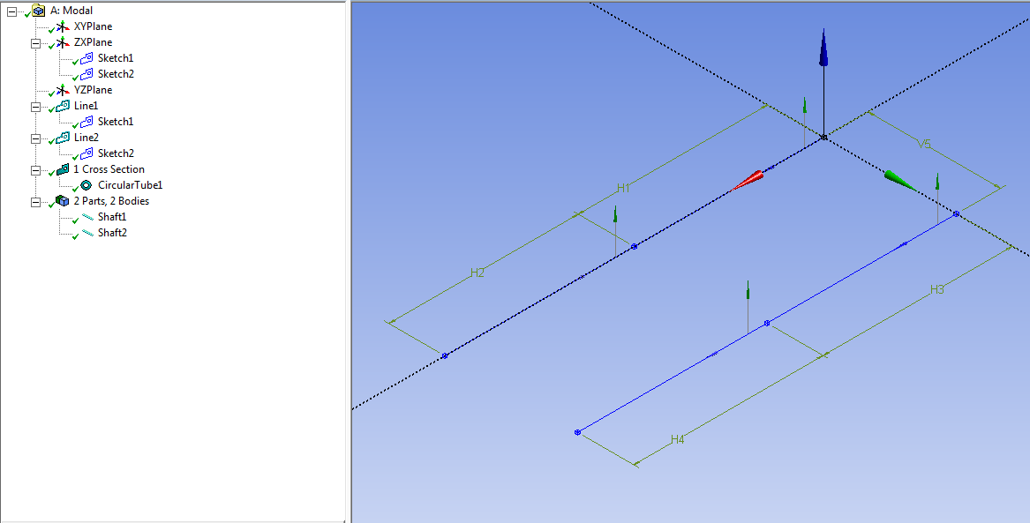
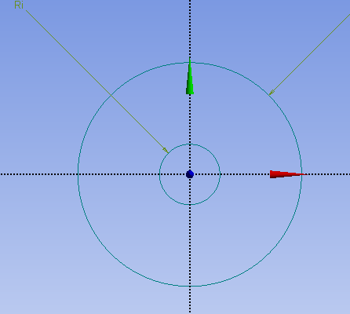
Geared Shafts: Geometry in DM
2 line bodies + 1 construction point a each center
Common cross section

Slide 14
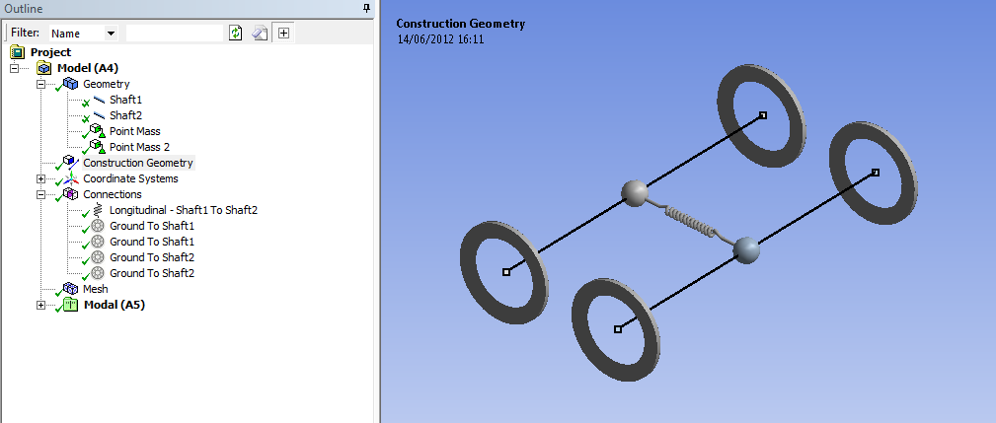
Geared Shafts: Connection
Gear mass is modeled with a point mass on each shaft
Gears interaction stiffness defined by a matrix27 element in command snippet ➔ spring defined to view the connection

Slide 15
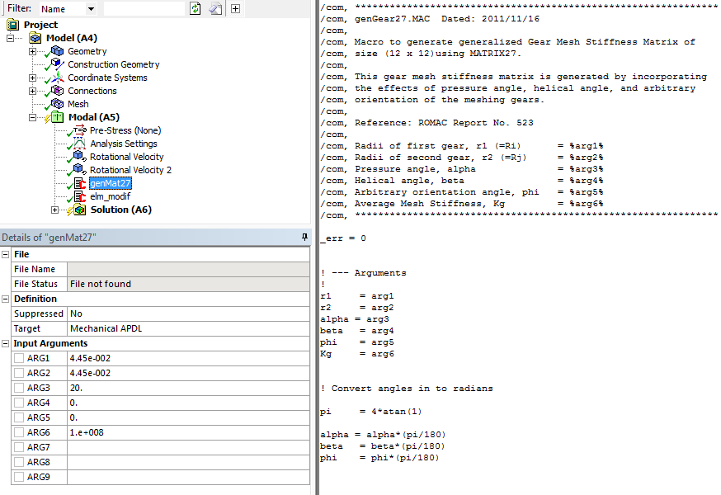
Geared Shafts: Gear Stiffness Definition
12x12 stiffness matrix stored in MATRIX27 element real constant set. The stiffness characteristics are calculated using an APDL language macro
Changing type and real constant set of the spring element

Slide 16
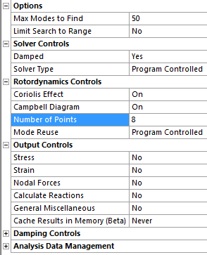
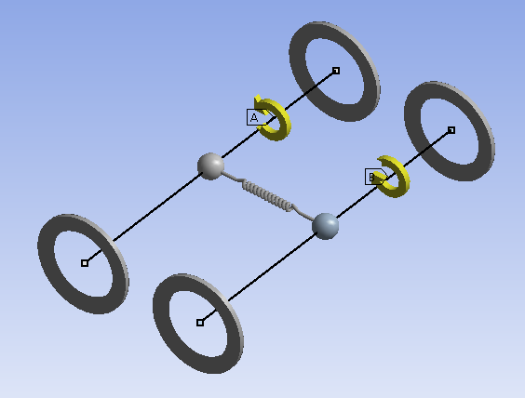
Geared Shafts: Solution Parameters
Both gears have the same radius - equal rotating speeds of the shaft
Damped Eigensolver must be enabled when Coriolis effect is turned on

Slide 17
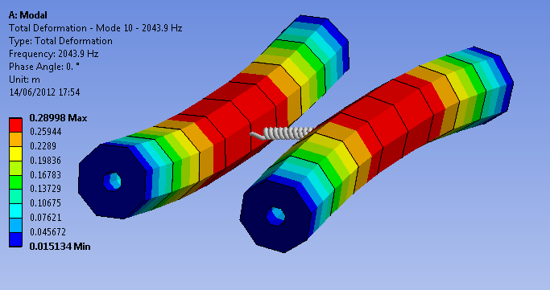
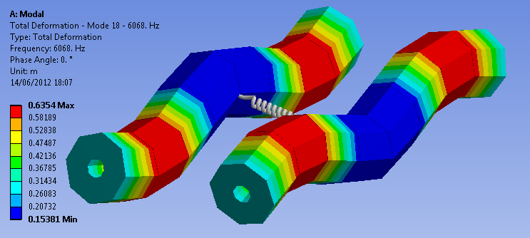
Geared Shafts: Solution Output
Coupled 1st lateral mode
Ω = 0 RPM
Coupled 3rd lateral mode

Slide 18
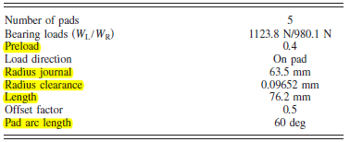
Optimization: 8 stages compressor*
Optimization of the parameters of the tilting pad bearings and rotor to minimize the power loss at bearings
The bearing loads are not equal - different stiffness and damping coefficients are input for left and right bearing
Multiple variable parameters highlighted below plus middle shaft radius parameter
Initial bearing design characteristics
Station 11
Station 24
Station 4
Station 17
Station 31
Bearing radius and length variation induce local modification of the dimensions of the shaft
* Based on ROMAC Report No. 556: “Constrained design optimization of rotor-tilting pad bearing systems”

Slide 19
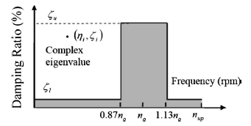
Optimization: Constraints
Stability constraint specified for the natural frequencies and associated damping ratios around the operating speed n0 = 5000 rpm
The gray area represents the unfeasible zone
This constraint cannot be input directly in DesignXplorer (DX). The frequency and damping ratios are automatically sent to an Excel sheet which sends back 1 if the constraint is respected and 0 otherwise.
20%
2%

Slide 20
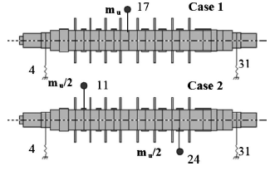
Optimization: Constraints
Damped unbalance response is determined between 1000 and 6000 rpm (16.7 to 100 Hz) for 2 configurations:
First bending mode excited with unbalance at station 17 (F0 = 2.42e-3 kg.m)
Second bending mode excited with unbalances at stations 11 and 24 and phase shift 180 deg (F0/2)
Maximum displacements:
At bearing locations: 20 μm
At mass locations: 40 μm

Slide 21
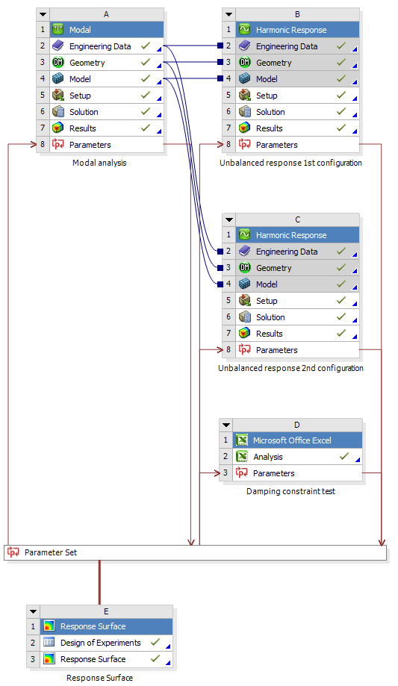
Optimization: Project
Bearings input parameters
Modal frequencies and damping ratios output
Maximum displacements output
Testing on damping ratios
Starting with response surfaces, first step towards optimization

Slide 22
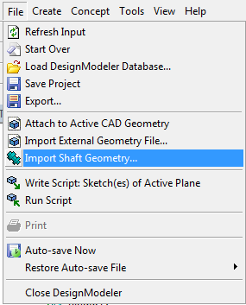
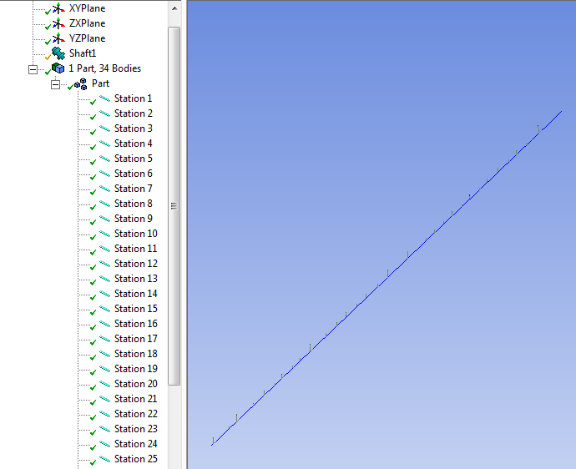
Optimization: Geometry Input
Shaft definition: Import shaft geometry tool
Shaft geometry file contains the length of each element, outer and inner diameters.
No limit to the number of stations.
Only circular cross sections.

Slide 23
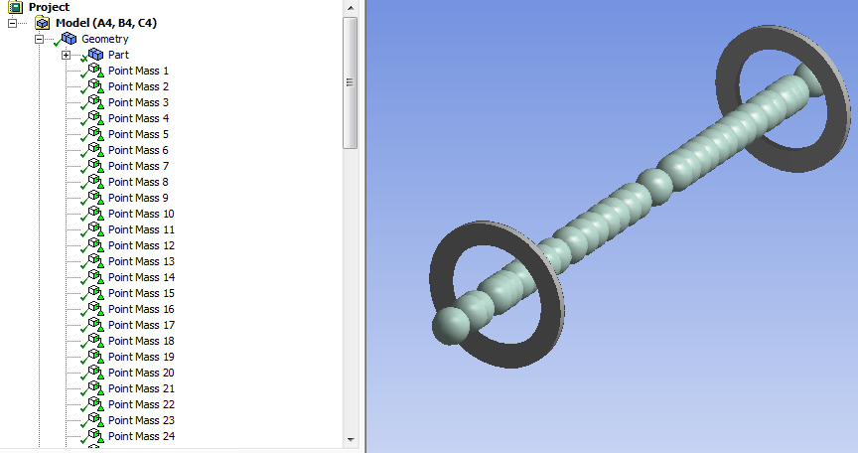
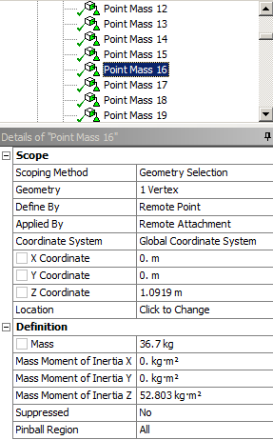
Optimization: Lumped masses
Point masses are added at each node (x 35)
15 of them have rotary inertia

Slide 24
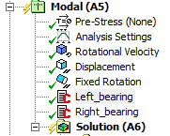
Optimization: Bearings
Stiffness and damping coefficients of the bearings are calculated using THPAD directly called from the project
1. Writing THPAD input file
THPAD reads input in US customary units
(sample of the THPAD input file preparation)
3. Reading THPAD output file
2. Calling THPAD
4. Replacing values in real constant set

Slide 25
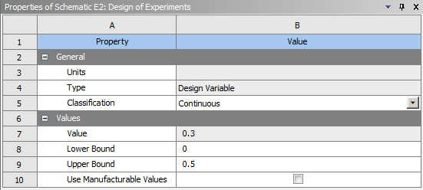
Optimization: Analysis inputs
Analysis ran for multiple values of input parameters
Only two parameters for model validation:
Bearing radius
Bearing pre-load
Sample of pre-load evaluations
Input parameters scoped independently to verify their effects on output parameters

Slide 26
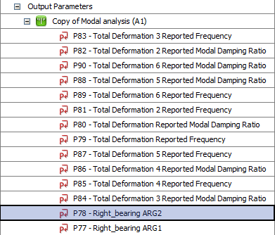
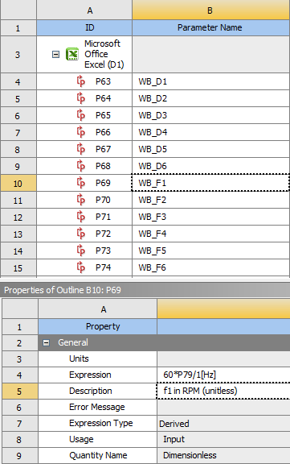
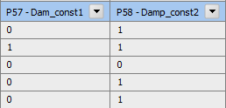
Optimization: modal analysis output
Frequencies and damping ratios of the first 6 modes are retrieved and sent to the excel sheet
Excel box input window
Design of experiment: modal output parameters
Boolean output:
1: damping ok
0: damping not ok

Slide 27
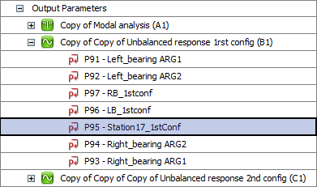
Optimization: Harmonic Analysis Output
Retrieving maximum displacements at both bearings and application points of unbalanced loads
Displacement plotted to visualize the effect of the input parameters
Unbalanced load applied on central mass in the 1st configuration

Slide 28
Summary
The previous slides have described the elements of complete rotordynamics analysis with ANSYS. Key enabling features:
CAD import and automatic meshing
Library of elements
All analysis types (including prestress)
Dedicated post-processing
Multi-spool dynamics simulation
Direct connection to bearing codes
Account for the flexibility of the supporting structure and/or the disks
Connect directly to other ANSYS tools via Workbench (for example Design Xplorer)
Continuous work on:
Features
Performances
Procedures
Interfaces

Slide 29
Thank you for your attention

